Slide 1

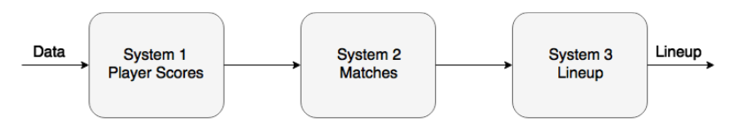
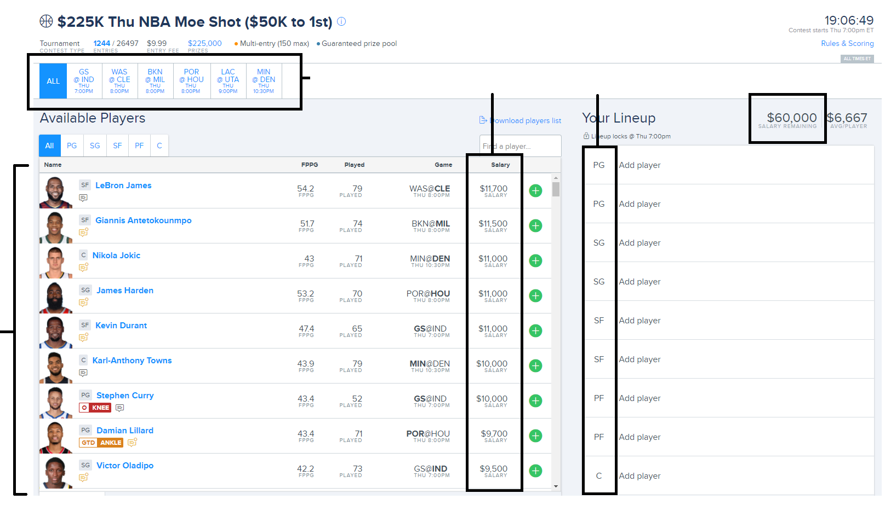
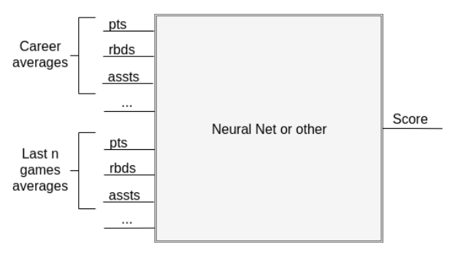
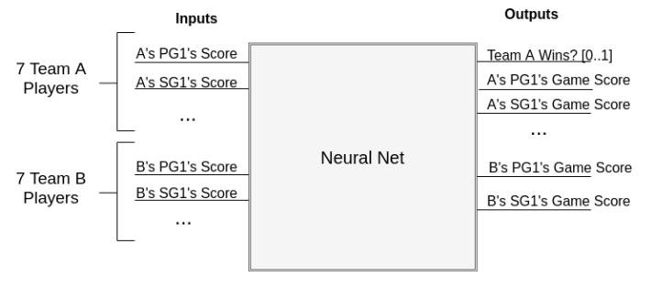
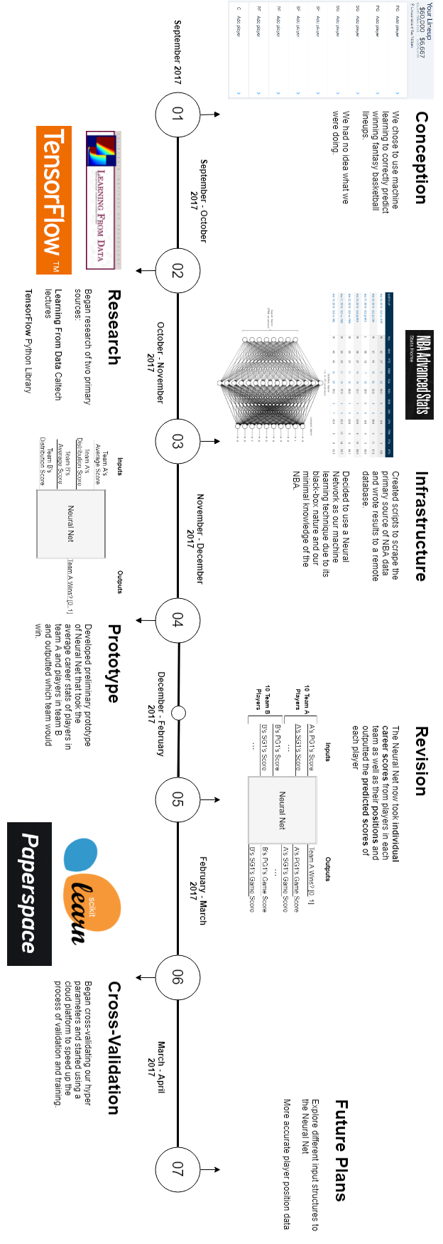



PICKING WINNERS FOR FANTASY BASKETBALL WITH MACHINE LEARNING
Date: April 5th 2018
ECSE 457 Design Project
Group 23
1
Objective & Background
The goal of this project was to make a machine learning system that could compete profitably in daily fantasy NBA competitions.
Daily: happen every day that there are matches, and never last more than a day
Fantasy: uses an artificial points system (e.g. 1.2 points for a rebound)
NBA: based on games that are actually happening in the NBA
Competitions: Actively competing against other real people (or machines?)
In these competitions, you have to select 9 basketball players of specific positions (center, forward, etc.) who are playing tonight, in real games, across any teams. Each player has a salary, and you have a budget. The goal of the competition is to maximize the amount of fantasy points your lineup gets.
Today’s
Games
Player
Salaries
Required
Positions
Budget
Today’s
Players
4
Results
Our goal was to build a machine learning system that could predict these lineups and maybe even win some money (unlikely!)
2
Data Collection
The inputs to our system are NBA statistics. We built a scraper to grab data from the NBA website. We scraped partial data from games back to 1970, and complete back to 2004:
5
Timeline
We used Python to power our scraper,
the BeautifulSoup library to access the NBA website,
and Selenium to control the NBA website
6
Future Plans
3
?

